Slide 1

Course Name:
COMPILER DESIGN
Course code:
SCS1303

Slide 2
UNIT 3
INTERMEDIATE CODE GENERATION
Syntax directed translation scheme
Three Address Code
Representation of three address code
Intermediate code generation for:
Assignment statements
Boolean statements
Switch case statement
Procedure call
Symbol Table Generation

Slide 3
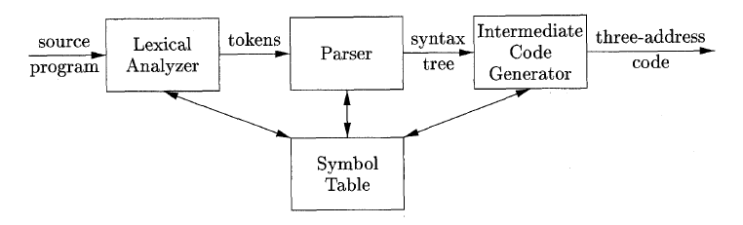
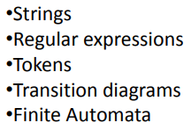
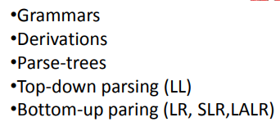
Introduction

Slide 4


Rest of Analysis Phase
To help in semantic analysis.
To help in intermediate code generation .
Two tools are used:
Semantic rules
Semantic actions

Slide 5
Syntax Directed Translation(SDT)
The notational framework for intermediate code generation is an extension of context-free grammar called syntax-directed translation scheme.
It allows subroutines or semantic actions to be attached to the productions of a CFG.
Grammar symbols are associated with attributes to associate information with the programming language constructs that they represent.
Values of these attributes are evaluated by the semantic rules associated with the production rules.
Grammar + semantic rule = SDT (syntax directed translation)

Slide 6
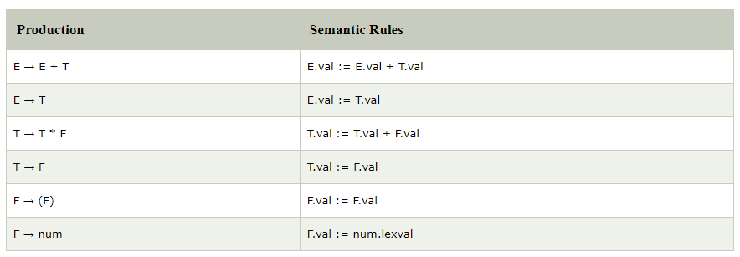
EXAMPLE

Slide 7
SDT (Contd..)
Evaluation of the semantic rules:
may generate intermediate codes
may put information into the symbol table
may perform type checking
may issue error messages
may perform some other activities
An attribute may hold almost any thing.
a string, a number, a memory location, a complex record.

Slide 8
SDT (Contd..)
When we associate semantic rules with productions, we use two notations:
– Syntax-Directed Definitions
– Translation Schemes
Syntax-Directed Definitions:
give high-level specifications for translations
hide many implementation details such as order of evaluation of semantic actions.
Translation Schemes:
indicate the order of evaluation of semantic actions associated with a production rule.
In other words, translation schemes give a little bit information about implementation details.

Slide 9
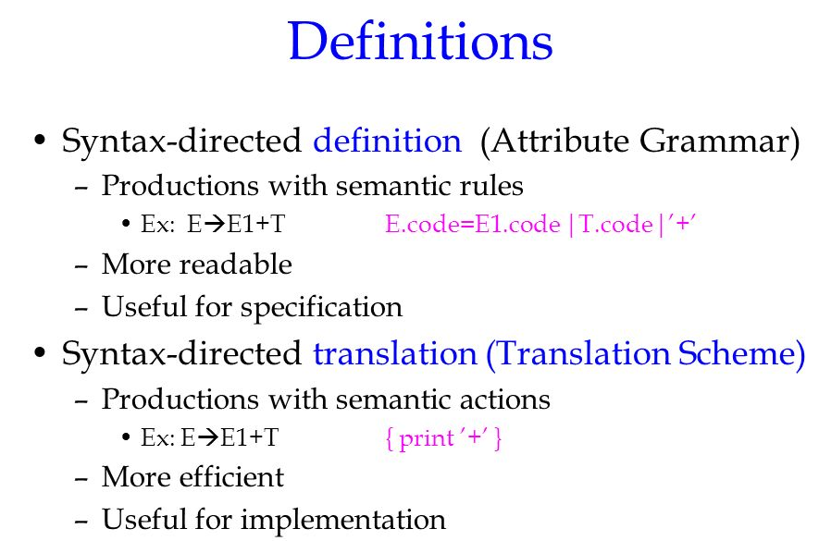

Slide 10
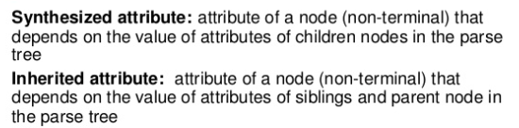
Syntax-Directed Definitions
A syntax-directed definition is a generalization of a context-free grammar in which:
Each grammar symbol is associated with a set of attributes.
This set of attributes for a grammar symbol is partitioned into two subsets called synthesized and inherited attributes of that grammar symbol.
Each production rule is associated with a set of semantic rules.
A→XYZ {Y.VAL=2*A.VAL}

Slide 11
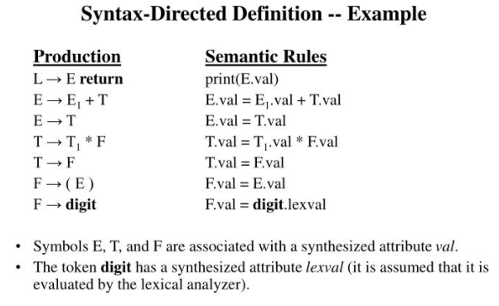

Slide 12
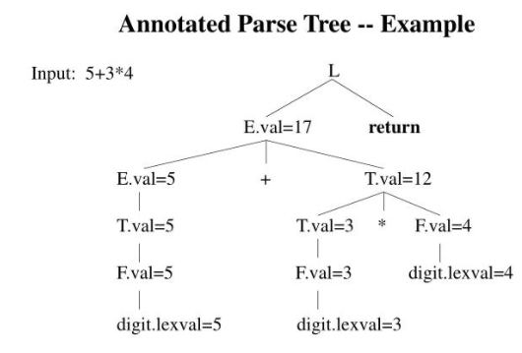
Annotated Parse Tree
A parse tree showing the values of attributes at each node is called an annotated parse tree.
The process of computing the attributes values at the nodes is called annotating(or decorating) of the parse tree.
Of course, the order of these computations depends on the dependency graph induced by the semantic rules.

Slide 13
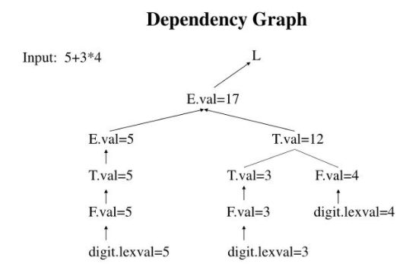
Syntax-Directed Definitions
Semantic rules set up dependencies between attributes which can be represented by a dependency graph.
This dependency graph determines the evaluation order of these semantic rules.
The flow of information happens bottom-up and all the children attributes are computed before parents.

Slide 14
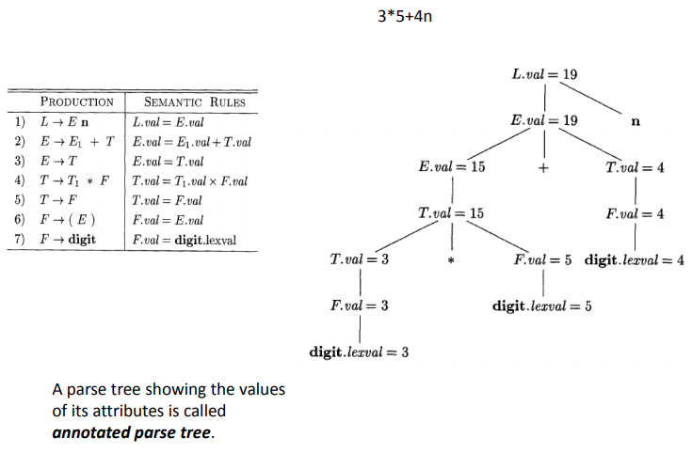
Example

Slide 15
Implementation of SDT
Use an extra fields in the parser stack entries corresponding to the grammar symbols.
These fields hold the values of the corresponding translations.
STATE
VAL
Z | Z.VAL
Y | Y.VAL
X | X.VAL
 | .
 | .
TOP
STACK BEFORE REDUCTION

Slide 16
SDT scheme for Desk calculator
Production
Semantic Action
S → E $ { printE.VAL }
E → E₁ + E₂ {E.VAL := E₁.VAL + E₂.VAL }
E → E₁ * E₂ {E.VAL := E₁.VAL * E₂.VAL }
E → (E₁) {E.VAL := E₁.VAL }
E → I {E.VAL := I.VAL }
I → I₁ digit {I.VAL := 10 * I₁.VAL + LEXVAL }
I → digit { I.VAL:= LEXVAL}

Slide 17
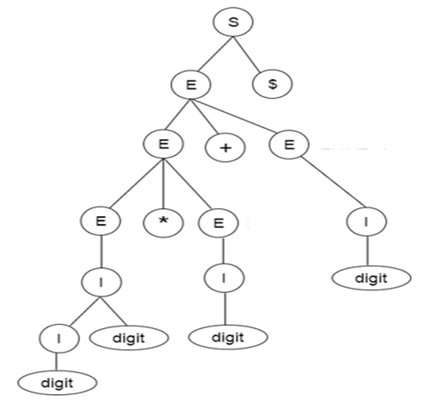
Parse Tree
S → E $
E → E₁ + E₂
E → E₁ * E₂
E → (E₁)
E → I
I → I₁ digit
I → digit
Input: 23*5+4$

Slide 18
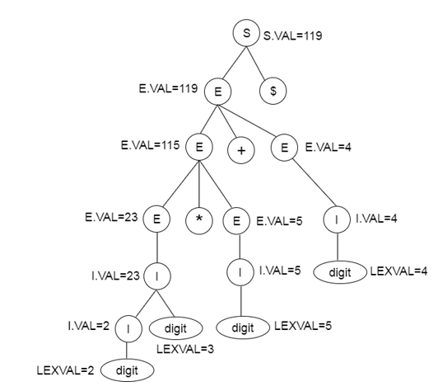
Parse tree with translations
Input: 23*5+4$

Slide 19
Implementation of Desk calculator
Production
Program Fragment
S → E $ print VAL[TOP]
E → E + E VAL[TOP] := VAL[TOP] + VAL[TOP-2]
E → E * E VAL[TOP] := VAL[TOP] * VAL[TOP-2]
E → (E) VAL[TOP] := VAL[TOP-1]
E → I none
I → I digit VAL[TOP] := 10 * VAL[TOP] + LEXVAL
I → digit VAL[TOP] := LEXVAL}
E | E.VAL
+
E | E.VAL
 | .
TOP

Slide 20
Sequence of Moves
Moves | Input | STATE | VAL | Production used
(1) | 23*5+4$ | _ | _
(2) | 3*5+4$ | 2 | _
(3) | 3*5+4$ | I | 2 | I → digit
(4) | *5+4$ | I3 | 2_
(5) | *5+4$ | I | (23) | I → I digit
(6) | *5+4$ | E | (23) | E → I
(7) | 5+4$ | E* | (23) _
(8) | +4$ | E*5 | (23) _ _
(9) | +4$ | E*I | (23) _ 5 | I → digit
(10) | +4$ | E*E | (23) _ 5 | E → I
(11) | +4$ | E | (115) | E → E * E
(12) | 4$ | E+ | (115) _
(13) | $ | E+4 | (115) _4
(14) | $ | E+I | (115) _4 | I → digit
(15) | $ | E+E | (115) _4 | E → I
(16) | $ | E | (119) | E → E + E
(17) | _ | E$ | (119) _
(18) | _ | S | PRINT 119 | S → E $

Slide 21
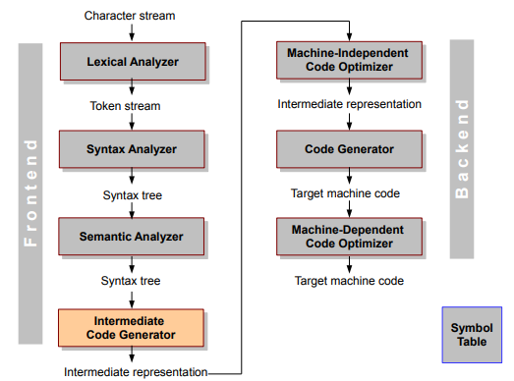
Intermediate Code

Slide 22
In the analysis-synthesis model of a compiler, the front end of a compiler translates a source program into an independent intermediate code, then the back end of the compiler uses this intermediate code to generate the target code (which can be understood by the machine).
The benefits of using machine independent intermediate code are:
Intermediate code eliminates the need of a new full compiler for every unique machine by keeping the analysis portion same for all the compilers.
The second part of compiler, synthesis, is changed according to the target machine.
It becomes easier to apply the source code modifications to improve code performance by applying code optimization techniques on the intermediate code.

Slide 23
Intermediate Representation
Intermediate codes can be represented in a variety of ways and they have their own benefits.
High Level IR - High-level intermediate code representation is very close to the source language itself. They can be easily generated from the source code and we can easily apply code modifications to enhance performance. But for target machine optimization, it is less preferred.
Low Level IR - This one is close to the target machine, which makes it suitable for register and memory allocation, instruction set selection, etc. It is good for machine-dependent optimizations.
Intermediate code can be either language specific (e.g., Byte Code for Java) or language independent (three-address code).

Slide 24
What is intermediate code?
During the translation of a source program into the object code for a target machine, a compiler may generate a middle-level language code, which is known as intermediate code or intermediate text.
The complexity of this code lies between the source language code and the object code.
The intermediate code can be represented in the form of:
Postfix notation,
Syntax tree,
Three-address code.

Slide 25
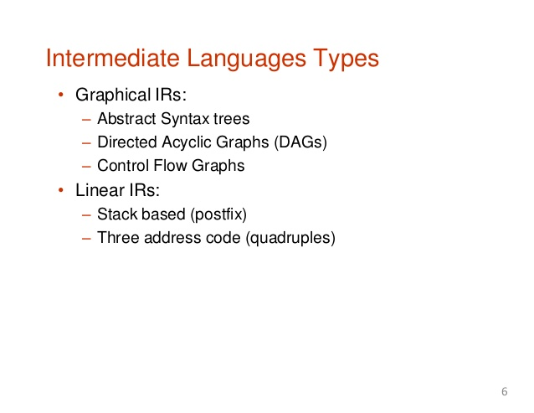

Slide 26
Postfix Notation
The ordinary (infix) way of writing the sum of a and b is with operator in the middle : a + b
The postfix notation for the same expression places the operator at the right end as ab +.
In general, if e1 and e2 are any postfix expressions, and + is any binary operator, the postfix notation is:
e1e2 +
No parentheses are needed in postfix notation because the position and arity (number of arguments) of the operators permit only one way to decode a postfix expression.

Slide 27
Postfix Notation (Contd..)
Postfix notation is the useful form of intermediate code if the given language is expressions.
Postfix notation is also called as 'suffix notation' and 'reverse polish'.
Postfix notation is a linear representation of a syntax tree.
In the postfix notation, any expression can be written unambiguously without parentheses.

Slide 28
Example
The postfix representation of the expression
(a+b)*c ab+c*
a*(b+c) abc+*
(a+b)*(c+d) ab+cd+*
(a – b) * (c + d) + (a – b) ab - cd + *ab - +
Let us introduce a 3-ary (ternary) operator ,the conditional expression. Consider if e then x else y ,whose value is
Using ? as a ternary postfix operator, we can represent this expression as:
exy?

Slide 29
Example
What is the postfix?
if a then if c-d then a+c else a*c else a+b
Soln:
acd-ac+ac*?ab+?

Slide 30
Evaluation of Postfix Expression
Consider the postfix expression ab+c*.Suppose a,b and c have values 1,3 and 5 respectively.
To evaluate 13+5*,perform the following:
Stack 1
Stack 3
Add the two topmost elements ,pop them off stack and the stack the result 4.
Stack 5
Multiply the two topmost elements ,pop them off stack and the stack the result 20.
The value on top of the stack at the end is the value of the entire expression

Slide 31
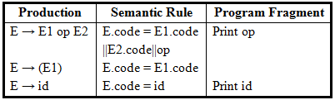
Syntax-Directed translation to Postfix code
E.Code is a string-valued translation
The value of the translation E.code for the first production is the concatenation of E⁽¹⁾.code , E⁽²⁾.code and the symbol op

Slide 32
Sequence of moves
Processing the input a+b*c ,a syntax-directed translator based on an LR parser, has the following sequence of moves:
Shift a
Reduce by E→ id and print a
Shift +
Shift b
Reduce by E→ id and print b
Shift *
Shift c
Reduce by E→ id and print b
Reduce by E→ E op E and print *
Reduce by E→ E op E and print +

Slide 33
Syntax Tree
Syntax tree is nothing more than condensed form of a parse tree.
The operator and keyword nodes of the parse tree are moved to their parents and a chain of single productions is replaced by single link in syntax tree the internal nodes are operators and child nodes are operands.
To form syntax tree put parentheses in the expression, this way it's easy to recognize which operand should come first.

Slide 34
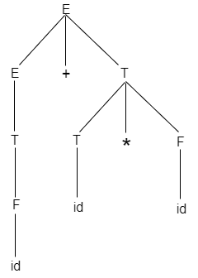
Parse tree vs. Syntax tree
A parse tree contains more details than actually needed. So, it is very difficult to compiler to parse the parse tree. Take the following parse tree as an example:

Slide 35
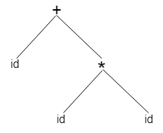
Parse tree vs. Syntax tree
In the parse tree, most of the leaf nodes are single child to their parent nodes.
In the syntax tree, we can eliminate this extra information.
Syntax tree is a variant of parse tree. In the syntax tree, interior nodes are operators and leaves are operands.
Syntax tree is usually used when represent a program in a tree structure.
A sentence id + id * id would have the following syntax tree:

Slide 36
Example
The syntax tree for the expression a*(b+c)/d
The syntax tree for the statement if a=b then a=c+d else b=c-d
/
*
d
a
+
b
c
if-then-else
=
=
=
a
b
a
b
-
+
c
d
c
d

Slide 37
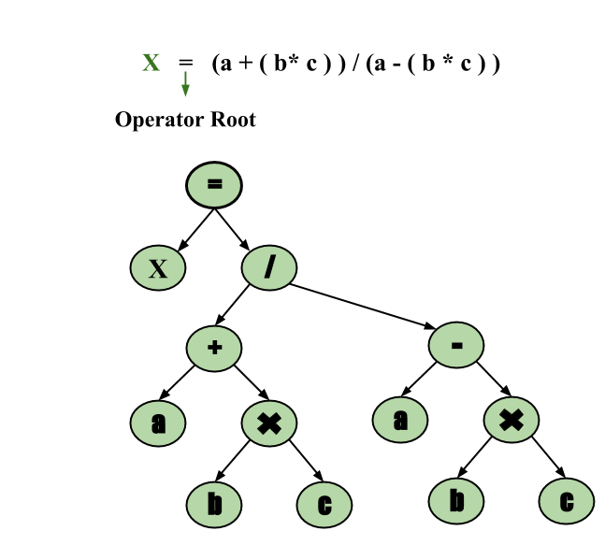
Example: x = (a + b * c) / (a – b * c)

Slide 38
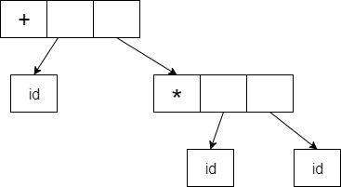
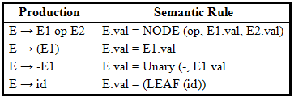
Syntax-directed construction of syntax tree
Abstract syntax tree can be represented as:
Abstract syntax trees are important data structures in a compiler. It contains the least unnecessary information.
Abstract syntax trees are more compact than a parse tree and can be easily used by a compiler.

Slide 39
Three address code
Three-address code is an intermediate code. It is used by the optimizing compilers.
In three-address code, the given expression is broken down into several separate instructions. These instructions can easily translate into assembly language.
Each three address code instruction has at most three operands. It is a combination of assignment and a binary operator.

Slide 40
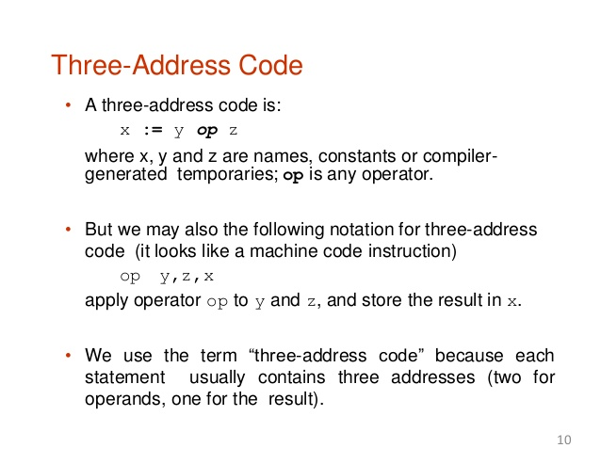

Slide 41
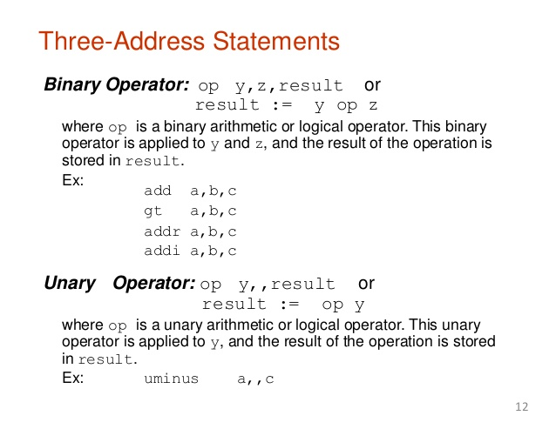

Slide 42
Example
Given an Expression:
a := (-c * b) + (-c * d)
Three-address code is as follows:
t₁ := -c
t₂ := b*t₁
t₃ := -c
t₄ := d * t₃
t₅ := t₂ + t₄
a := t₅
t is used as registers in the target program.
The three address code can be represented in two forms: quadruples and triples (and indirect triples).

Slide 43
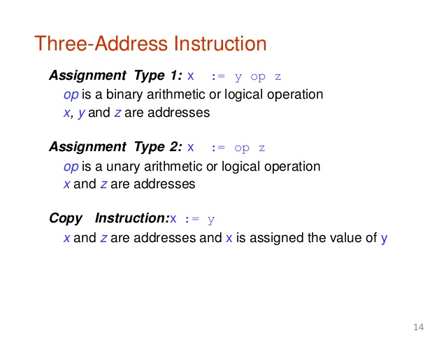
Types of Three Address code

Slide 44
Unconditional Jump:
goto L
Jumps to the three address code with the label L and the execution continues from that statement.
e.g. goto L
...
...
L: x=y+z
...
Conditional Jump:
If x relop y goto L

Slide 45
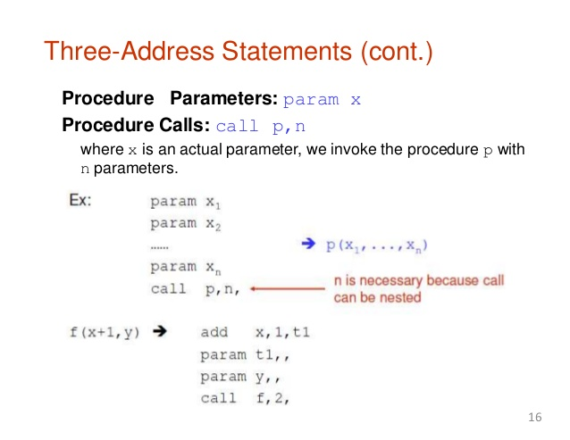

Slide 46
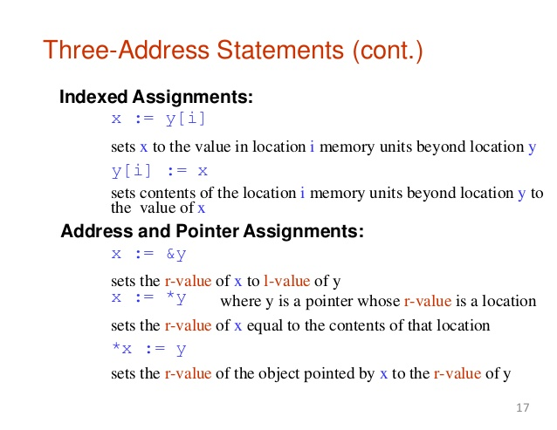

Slide 47
Three-address statements
x:=y op z assignment
x:=op y unary assignment
x:=y copy
goto L unconditional jump
if x relop y goto L conditional jump
param x procedure call
call p n procedure call
return y procedure call
x:=y[i] indexed assignment
x[i]:=y indexed assignment
x:=&y pointer assignment
x:=*y pointer assignment
*x=y pointer assignment

Slide 48
The three address code can be represented by:
Quadruples
Triples and
Indirect triples.

Slide 49
Quadruple
It is structure with consist of 4 fields namely op, arg1, arg2 and result.
op denotes the operator
arg1 and arg2 denotes the two operands and
result is used to store the result of the expression.
Advantage :
Easy to rearrange code for global optimization.
Can quickly access value of temporary variables using
symbol table.
Disadvantage :
Contain lot of temporaries.
Temporary variable creation increases time and space
complexity.

Slide 50
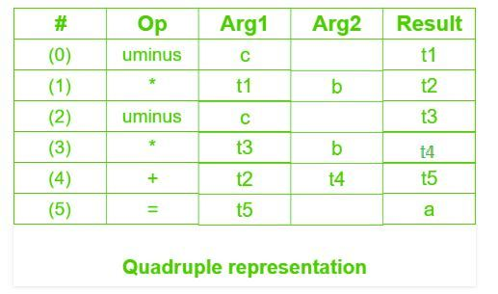
Example : Consider expression a = b * – c + b * – c.
The three address code is:
t1 = uminus c
t2 = b * t1
t3 = uminus c
t4 = b * t3
t5 = t2 + t4
a = t5

Slide 51
Triples
Doesn’t make use of extra temporary variable.
A reference to another triple’s value is needed, a pointer to
that triple is used.
So, it consist of only three fields namely op, arg1 and arg2.
Disadvantage :
Temporaries are implicit and difficult to rearrange code.
It is difficult to optimize because optimization involves moving intermediate code. When a triple is moved, any other triple referring to it must be updated also.
With help of pointer one can directly access symbol table entry.

Slide 52
Example : Consider expression a = b * – c + b * – c

Slide 53
Triples Eg.
Unconditional jump:
goto L // for label Triples
Conditional jump:
if x < y goto L
op | arg1 | arg2
goto | L | --
op | arg1 | arg2
< | x | y
if | (0) | L
(0)
(1)

Slide 54
Indexed statements:
x := y[i]
x[i] := y
op | arg1 | arg2
=[] | y | i
= | x | (0)
(0)
(1)
op | arg1 | arg2
[]= | x | i
= | (0) | y
(0)
(1)

Slide 55
Indirect Triples
This representation makes use of pointer to the listing of all references to computations which is made separately and stored.
Its similar in utility as compared to quadruple representation but requires less space than it.

Slide 56
Example : Consider expression a = b * – c + b * – c

Slide 57
Problem
Write quadruple, triples and indirect triples for following expression :
(x + y) * (y + z) + (x + y + z)
The three address code is:
t1 = x + y
t2 = y + z
t3 = t1 * t2
t4 = t1 + z
t5 = t3 + t4

Slide 59
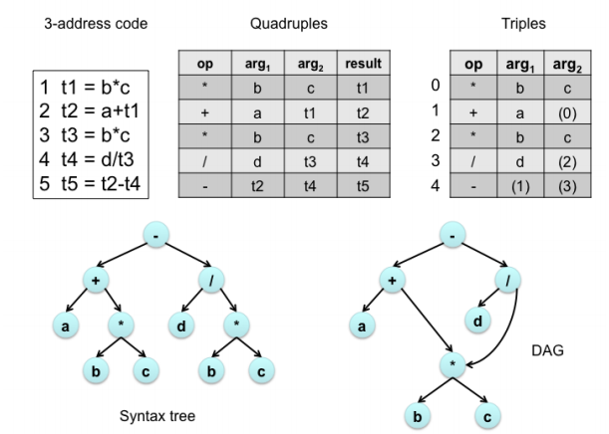
Implementation
The three-address code for (a+(b*c))-d/(b*c) is below :

Slide 60
# Calculate one solution to the [[Quadratic equation]].
x = (-b + sqrt(b^2 - 4*a*c)) / (2*a)
t1 := b * b
t2 := 4 * a
t3 := t2 * c
t4 := t1 - t3
t5 := sqrt(t4)
t6 := - b
t7 := t5 + t6
t8 := 2 * a
t9 := t7 / t8
x := t9

Slide 61
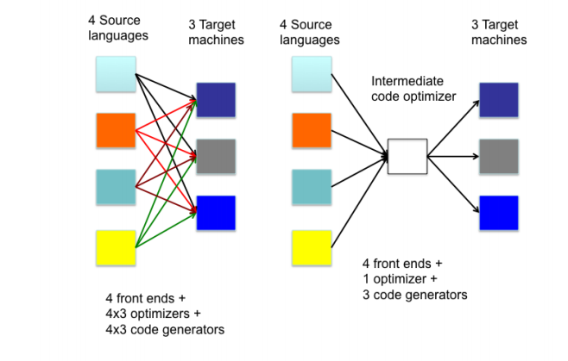
Why IR?

Slide 62
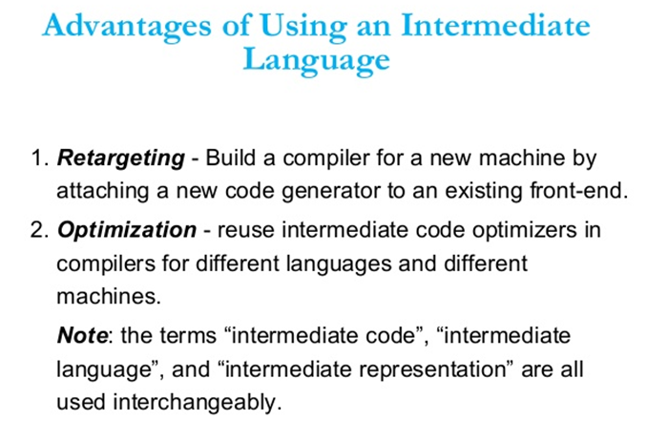

Slide 63
Next Topics
Intermediate code generation for:
Assignment statements
Boolean statements
Switch case statement
Procedure call

Slide 64
Translation of Assignment Statement
In the syntax directed translation, assignment statement is mainly deals with expressions.
The expression can be of type real, integer, array…
Consider the grammar
S → id := E
E → E₁ + E₂
E → E₁ * E₂
E → (E₁)
E → id

Slide 65
SDT into Three address code
The non-terminal E has two attributes:
E.place , the name that will hold the value of E
E.code , the sequence of three address statements evaluating E
The value of the non-terminal E on the left side of E → E₁ + E₂ will be computed into a new temporary t.
The three address code for id=E consist of code to evaluate E into some temporary t ,followed by the assignment id.place=t.
The Synthesized attribute S.code represents the three address code for the assignment S.
S → id := E
E → E₁ + E₂
E → E₁ * E₂
E → (E₁)
E → id

Slide 66
The function NEWTEMP() returns a sequence of distinct names t₁,t₂,.... in response to successive calls.
We use the notation gen(x ‘=’ y ‘+’ z) represent the three address statement x = y + z
GEN (A=B+C) procedure is used to emit the three address statement A=B+C with actual values substituted for A,B and C.
GEN would enter the operator + , and the values of A,B and C into the quadruple array.

Slide 67
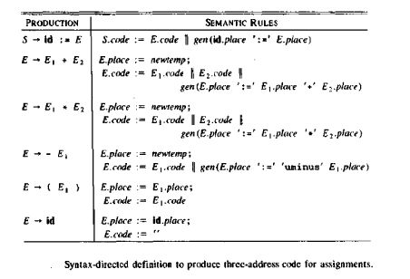
{ id = look_up(id.name); If p ≠ nil then gen (id = E.place) Else Error; }
T=NEWTEMP()
E.PLACE=T

Slide 68
Trace of Syntax-directed translation
Input | Stack | PLACE | Generated Code
A= − B*(C+D)
= − B*(C+D) | id | A
− B*(C+D) | id= | A −
B*(C+D) | id = − | A− −
*(C+D) | id = − id | A− − B
*(C+D) | id = − E | A− − B | T₁ = - B
*(C+D) | id = E | A− T₁
(C+D) | id= E * | A− T₁ −
C+D) | id= E * ( | A− T₁ − −
+D) | id= E * ( id | A− T₁ − − C
+D) | id= E * ( E | A− −T₁ − − C
D) | id= E * ( E + | A− T₁ − − C −
) | id= E * ( E + id | A− T₁ − − C − D
) | id= E * ( E + E | A− T₁ − − C − D | T₂ = C + D
) | id= E * ( E | A− T₁ − − T₂
 | id= E * ( E ) | A− T₁ − − T₂ −
 | id= E * E | A− T₁ − T₂ | T₃ = T₁ * T₂
 | id= E | A− T₃ | A = T₃
 | S | S

Slide 69
Assignment Statement with mixed types
The constants and variables would be of different types,hence the compiler must either reject certain mixed-mode operations or generate appropriate coercion (mode conversion) instructions.
Consider two modes:
REAL
INTEGER, with integer converted to real when necessary.
An additional field in translation for E is E.MODE whose value is either REAL or INTEGER

Slide 70
The semantic rule for E.MODE associated with the production E → E₁ + E₂ is:
E → E₁ + E₂ {if E₁.MODE = INTEGER and E₂.MODE = INTEGER then E.MODE = INTEGER
else E.MODE = REAL }
When necessary the three address code
A=inttoreal B is generated,
whose effect is to convert integer B to a real of equal value called A.

Slide 71
Example
X=Y+I*J
Assume X and Y to be REAL and I and J have mode INTEGER.
Three-addresss code:
T₁=I int * J
T₂= inttoreal T₁
T₃=Y real +T₂
X=T₃
The semantic rule uses two translation fields E.PLACE and E.MODE for the non-terminal E

Slide 72
Semantic rule for E → E₁ op E₂
T= NEWTEMP()
if E₁.MODE=INTEGER and E₂.MODE=INTEGER then
begin
GEN(T= E₁.PLACE int op E₂.PLACE)
E.MODE=INTEGER
end
else if E₁.MODE=REAL and E₂.MODE=REAL then
begin
GEN(T= E₁.PLACE real op E₂.PLACE)
E.MODE=REAL
end
else if E₁.MODE=INTEGER and E₂.MODE=REAL then
begin
U=NEWTEMP()
GEN(U= inttoreal E₁.PLACE)
GEN(T= U real op E₂.PLACE)
E.MODE=REAL
end
else if E₁.MODE=REAL and E₂.MODE=INTEGER then
begin
U=NEWTEMP()
GEN(U= inttoreal E₂.PLACE)
GEN(T= E₁.PLACE real op U)
E.MODE=REAL
end
E.PLACE=T

Slide 73
Boolean Expressions
Boolean expressions have two primary purposes.
They are used for computing the logical values.
They are also used as conditional expression that alter the flow of control, such as if-then-else or while-do.
Boolean expression are composed of the boolean operators(and ,or, and not) applied to elements that are boolean variables or relational expressions.
Relational expressions are of the form E₁ relop E₂ , where E₁ and E₂ are arithmetic expressions.

Slide 74
Boolean Expressions (Contd..)
Consider the grammar
E → E or E
E → E and E
E → not E
E → (E)
E → id relop id
E → TRUE E → id
E → FALSE
The relop is any of <,≤,=, ≠, >, or ≥.
We assume that or and and are left associative.
or has lowest precedence ,then and ,then not.

Slide 75
Methods of Translating Boolean Expressions
There are two methods of representing the value of a Boolean.
To encode true or false numerically
1 is used to denote true.
0 is used to denote false.
To evaluate a boolean expression analogously to an arithmetic expression.
Flow of control –representing the value of a boolean expression by a position reached in a program.
Used in flow of control statements such as if-then-else or while-do statements.

Slide 76
Translation into three-address code
Use of branching statements of the form
where A and B are simple variables or constants.
L is a quadruple label.
relop is any of <,≤,=, ≠, >, or ≥.
goto L
If A goto L
If A relop B goto L

Slide 77
Numerical Representation
First consider the implementation of boolean expressions using 1 to denote TRUE and o to denote FALSE.
Expressions will be evaluated from left to right.
e.g-1.
A or B and C
Three address sequence
T₁ = B and C
T₂ = A or T₁

Slide 78
Numerical Representation
e.g-2.
A relational expression A< B is equivalent to the conditional statement
if A < B then 1 else 0
Three address sequence:
(1) if A < B goto (4)
(2) T=0
(3) goto (5)
(4) T=1
(5) ---

Slide 79
Semantic Rules for Boolean Expression
E → E₁ or E₂ | {E.place = newtemp(); gen (E.place = E₁.place or E₂.place)}
E → E₁ + E₂ | {E.place = newtemp(); gen (E.place = E₁.place and E₂.place)}
E → NOT E₁ | {E.place = newtemp(); gen (E.place = not E₁.place)}
E → (E₁) | {E.place = E₁.place}
E → id₁ relop id₂ | { E.place = newtemp(); gen (if id₁.place relop.op id₂.place goto nextquad + 3); gen(E.place =0) gen(goto nextquad + 2) gen(E.place=1) }
E → TRUE | {E.place := newtemp(); gen(E.place=1)}
E → FALSE | {E.place := newtemp(); gen(E.place =0)}
T=NEWTEMP()
E.PLACE=T
Next available entry in quadruple

Slide 80
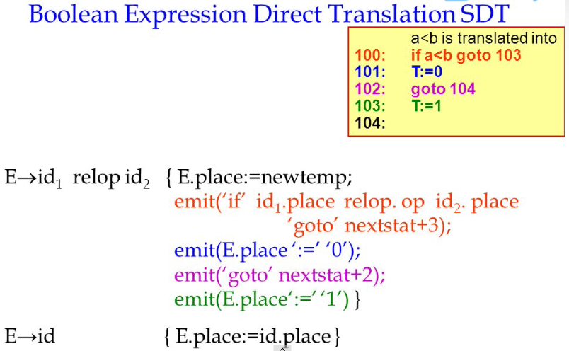

Slide 81
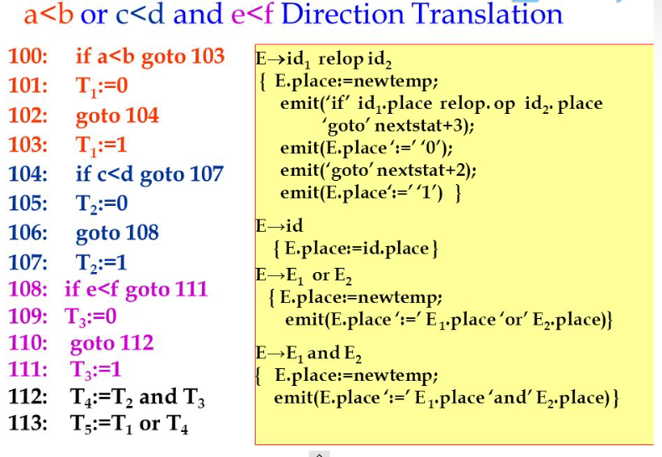

Slide 82
Translation of A< B or C
Three address code is:
(1) if A < B goto (4)
(2) T₁=0
(3) goto (5)
(4) T₁=1
(5) T₂ =T₁ or C
If triples are used the numbers must be changed
Unconditional jump: Conditional jump:
goto L if x < y goto L
op | arg1 | arg2
< | x | y
if | (0) | L
op | arg1 | arg2
goto | L | --
(0)
(1)

Slide 83
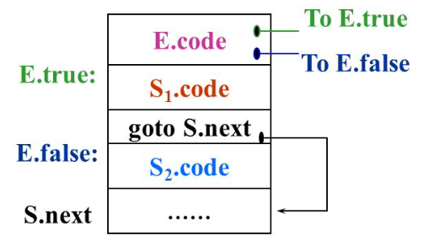
Control Flow Representation
Flow of control statements with the jump method. Consider the following : (short circuit code)
S → if E then S | if E then S₁ else S₂
S → while E do S₁rules.
if E then S₁ else S₂
if E then S₁ else S₂

Slide 84
Attributes used
if E then S₁ else S₂
E is associated with two labels
S.next - is a label that is attached to the first three address instruction to be executed after the code for S (S₁ or S₂)
E.true label which controls if E is true
E.false label which controls if E is false

Slide 85
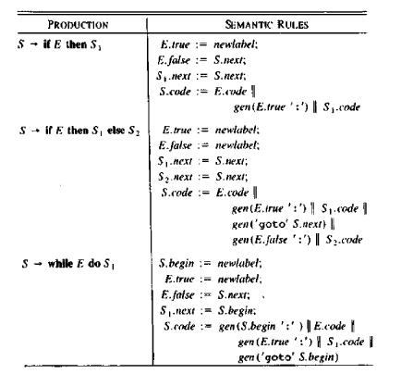
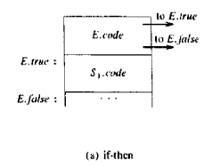
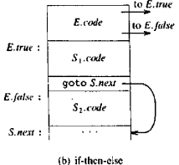
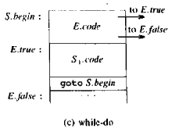

Slide 86
Example
if E then S₁ else S₂
E.true=newlabel
E.false= newlabel
S₁.next=S.next
S₂.next=S.next
S.code=E.code||
gen(E.true ‘:’)||
S₁.code ||
gen(goto S.next)||
gen(E.false ‘:’)||
S₂.code
The basic idea behind the translation: Suppose E is of the form A<B, then the generated code is of the form
if A<B goto E.true
goto E.false
e.g.
If A < B then A=A+1 else B=B+1
Three address code:
If A<B goto L1
goto L2
L1: A=A+1
goto L3
L2: B=B+1
L3: ----

Slide 87
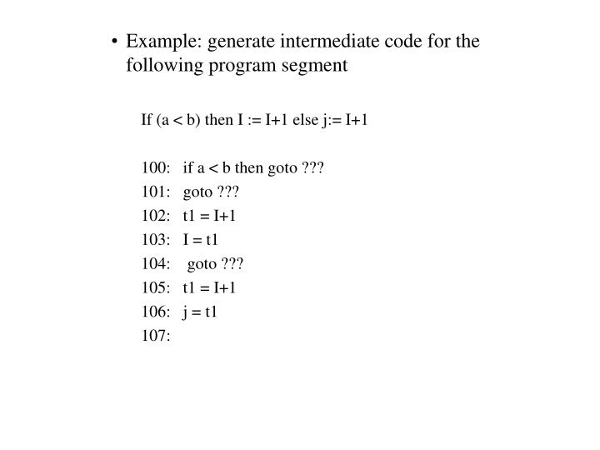

Slide 88
Backpatching
The syntax directed definition can be implemented in two or more passes (we have both synthesized attributes and inherited attributes).
Build the tree first
Walk the tree in the depth first order.
The main difficulty with intermediate code generation in one pass is that we may not know the target of a branch when we generate code for flow of control statements .
Backpatching is the technique to get around this problem.
Generate branch instructions with empty targets .
When the target is known, fill in the label of the branch instructions (backpatching).

Slide 89
Backpatching
Back Patching is putting the address instead of labels when the proper label is determined.
Back patching Algorithms perform three types of operations:
1) makelist (i) – creates a new list containing only i, an index into the array of quadruples and returns a pointer to the list it has made.
2) Merge (i, j) – concatenates the lists pointed to by i and j, and returns a pointer to the concatenated list.
3) Backpatch (p, i) – inserts i as the target label for each of the statements on the list pointed to by p.

Slide 90
Code for While-do Statement
Generate three address code for the following code-
while (A < C and B > D) do
C = C + 1
A = A + B
Three address code for the given code is-
if (A < C) goto (3)
goto (10)
if (B > D) goto (5)
goto (10)
T1 = c + 1
c = T1
T2 = A + B
A = T2
goto (10)
--

Slide 91
Code for While-do Statement
Generate three address code for the following code-
while (A < C and B > D) do
if A = 1 then C = C + 1
else
A = A + B
Three address code for the given code is-
if (A < C) goto (3)goto (15)
if (B > D) goto (5)
goto (12)
if (A = 1) goto (7)
goto (9)
T1 = c + 1
c = T1
goto (1)
T2 = A + B
A = T2
goto (1)
--

Slide 92
Code for do-while Statement
Generate three address code for the following code-
c = 0
do
{
if (a < b) then
x++;
else
x --;
c++;
} while (c < 5)
Three address code for the given code is-
c = 0
if (a < b) goto (4)
goto (7)
T1 = x + 1
x = T1
goto (9)
T2 = x – 1
x = T2
T3 = c + 1
c = T3
if (c < 5) goto (2)
--

Slide 93
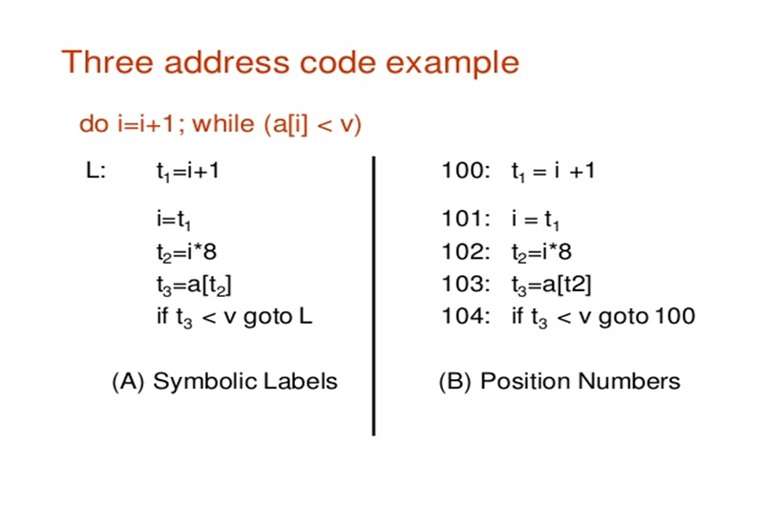

Slide 94
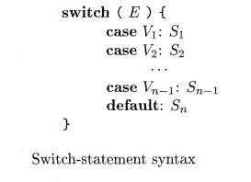
Case Statements
Switch and case statement is available in a variety of languages. The syntax of case statement is as follows:

Slide 95
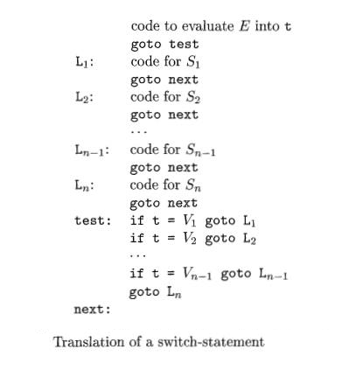
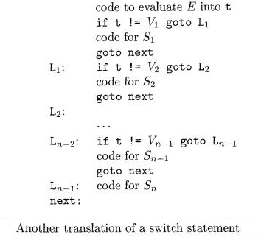
When switch keyword is seen then a new temporary t and two new labels test and next are generated.
When the case keyword occurs then for each case keyword, a new label L_{i} is created and entered into the symbol table.
The value of V_{i} of each case constant and a pointer to this symbol-table entry are placed on a stack.

Slide 96
Translation of Switch statement
Case V₁ L₁
Case V₂ L₂
.
.
.
Case V_{n-1} L_{n-1}
Case T, L_{n}
label NEXT
Equivalent code:
if T=V goto L

Slide 97
Code for Switch-case Statement
Generate three address code for the following code-
switch (ch)
{
case 1 : c = a + b;
break;
case 2 : c = a – b;
break;
}
Three address code for the given code is:
if ch = 1 goto L1
if ch = 2 goto L2
L1: T1 = a + b
c = T1
goto Last
L2: T1 = a – b
c = T2
goto Last
Last:

Slide 98
Procedure Calls
Procedure is an important and frequently used programming construct for a compiler. It is used to generate good code for procedure calls and returns.
Calling sequence:
The translation for a call includes a sequence of actions taken on entry and exit from each procedure. Following actions take place in a calling sequence:
When a procedure call occurs then space is allocated for activation record.
Evaluate the argument of the called procedure.
Save the state of the calling procedure so that it can resume execution after the call.
Also save the return address. It is the address of the location to which the called routine must transfer after it is finished.
Finally generate a jump to the beginning of the code for the called procedure.

Slide 99
Procedure Calls
Consider the grammar for a simple procedure call statement,
(1) S→ call id(Elist)
(2) Elist → Elist,E
(3) Elist → E
Argument list
Arguments separated by comma
Single argument

Slide 100
Syntax-Directed Translation
Production Rule | Semantic Action
S → call id(Elist) | {for each item p on QUEUE do GEN (param p) GEN (call id.PLACE) }
Elist → Elist, E | {append E.PLACE to the end of QUEUE }
Elist → E | {initialize QUEUE to contain only E.PLACE}
* QUEUE is used to store the list of parameters in the procedure
call.

Slide 101
Parse Tree
e.g. sum(x,y,z)
Three address code:
param x
param y
param z
call sum ,3
S
call
)
id
Elist
(
Elist
,
E
x | y | z
E.place=z
Elist
,
E
x | y
E.place=y
E.place=x
E
x

Slide 102
Example
Procedure call : sum(a+1,b,5)
void main()
{
sum(a+1,b,5);
}
void sum(int x,int y,int z)
Three address code:
T₁=a+1
T₂=5
param T₁
param b
param T₂
call sum,3

Slide 103
Next Topic:
Symbol Table

Slide 104
Symbol Table
An important data structure created and maintained by the compiler in order to keep track of semantics of variable .
It stores information about scope and binding information about names, information about instances of various entities such as variable and function names, classes, objects, etc.
It is built in lexical and syntax analysis phases.
The information is collected by the analysis phases of compiler and is used by synthesis phases of compiler to generate code.
It is used by compiler to achieve compile time efficiency.

Slide 105
It is used by various phases of compiler as follows :-
Lexical Analysis: Creates new table entries in the table, example like entries about token.
Syntax Analysis: Adds information regarding attribute type, scope, dimension, line of reference, use, etc in the table.
Semantic Analysis: Uses available information in the table to check for semantics i.e. to verify that expressions and assignments are semantically correct(type checking) and update it accordingly.
Intermediate Code generation: Refers symbol table for knowing how much and what type of run-time is allocated and table helps in adding temporary variable information.
Code Optimization: Uses information present in symbol table for machine dependent optimization.
Target Code generation: Generates code by using address information of identifier present in the table.

Slide 106
Symbol Table entries
Each entry in symbol table is associated with attributes that support compiler in different phases.
The symbol table is searched every time a name is encountered in the source text.
Changes to the table occur if a new name or new information about an existing name is discovered.
The symbol table grows dynamically even though fixed at compile time.
Each entry in the symbol table is for the declaration of a name.
The format of entries is not uniform.
Items stored in Symbol table:
Variable names and constants
Procedure and function names
Literal constants and strings
Compiler generated temporaries
Labels in source languages
The following information about identifiers are stored in symbol table.
The name.
The data type.
The block level.
Its scope (local, global).
Pointer / address
Its offset from base pointer
Function name, parameter and variable.

Slide 107
A symbol table may serve the following purposes depending upon the language :
To store the names of all entities in a structured form at one place.
To verify if a variable has been declared.
To implement type checking, by verifying assignments and expressions.
To determine the scope of a name (scope resolution).

Slide 108
Operations of Symbol table
The basic operations defined on a symbol table include:

Slide 109
Insert
Insert() operation is more frequently used in the analysis phase when the tokens are identified and names are stored in the table.
The insert() operation is used to insert the information in the symbol table like the unique name occurring in the source code.
In the source code, the attribute for a symbol is the information associated with that symbol. The information contains the state, value, type and scope about the symbol.
For example:
int x;
Should be processed by the compiler as:
insert (x, int)

Slide 110
Lookup
In the symbol table, lookup() operation is used to search a name.
It is used to determine:
The existence of symbol in the table.
The declaration of the symbol before it is used.
Check whether the name is used in the scope.
Initialization of the symbol.
Checking whether the name is declared multiple times.
The basic format of lookup() function is as follows:
lookup (symbol)
This format is varies according to the programming language.

Slide 111
Implementation
The symbol table can be implemented in the unordered list if the compiler is used to handle the small amount of data.
A symbol table can be implemented in one of the following techniques:
Linear (sorted or unsorted) list
Hash table
Binary search tree
Symbol table are mostly implemented as hash table.

Slide 112
List
An array is used to store names and associated information.
A pointer “available” is maintained at end of all stored records and new names are added in the order as they arrive.
To search for a name we start from beginning of list till available pointer and if not found we get an error “use of undeclared name”.
While inserting a new name we must ensure that it is not already present otherwise error occurs i.e. “Multiple defined name”.
Insertion is fast O(1), but lookup is slow for large tables – O(n) on average.
Advantage is that it takes minimum amount of space.

Slide 113
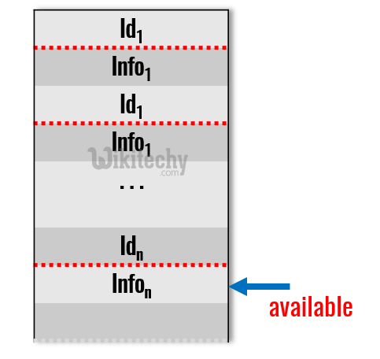
The compiler plans out the activation record for each procedure.
The simplest and easiest to implement data structure for a symbol table is a linear list of records.
We use a single array, or equivalently several arrays. To store names and their associated information.
If the symbol table contains n names, To find the data about a name, on the average, we search n/2 names, so the cost of an inquiry is also proportional to n.
Drawbacks:
As the array fills, collisions become more frequent – reduced performance.
Table size is an issue – dynamically increasing the table size is a difficulty.

Slide 114
Storing the characters of the name
Example:
static int a;
float b;
fixed length
e.g.
int calculate
int sum
int a,b
Name | Type | attribute
a | int | static
b | float | -
Name |  |  |  |  |  |  |  |  |  |  |  | Type
c | a | l | c | u | l | a | t | e |  |  |  | int
s | u | m |  |  |  |  |  |  |  |  |  | int
a |  |  |  |  |  |  |  |  |  |  |  | int
b |  |  |  |  |  |  |  |  |  |  |  | int

Slide 115
2. Variable length
0 | 1 | 2 | 3 | 4 | 5 | 6 | 7 | 8 | 9 | 10 | 11 | 12 | 13 | 14 | 15 | 16 | 17 | 18
c | a | l | c | u | l | a | t | e | $ | s | u | m | $ | a | $ | b | $
Starting index | length | type
0 | 10 | int
10 | 4 | int
14 | 2 | int
16 | 2 | int

Slide 116
Hash Tables for Symbol Tables
This method is generally more efficient than linear lists.
This scheme gives the capability of performing e inquiries on n names in time proportional to n ( n+e) / m, for any constant m.
The basic hashing scheme:
There are two parts to the data structure:
A hash table consisting of a fixed array of m pointers to table entries.
Table entries organized into m separate linked lists, called buckets (some buckets may be empty). Each record in the symbol table appears on exactly one of these lists.

Slide 117
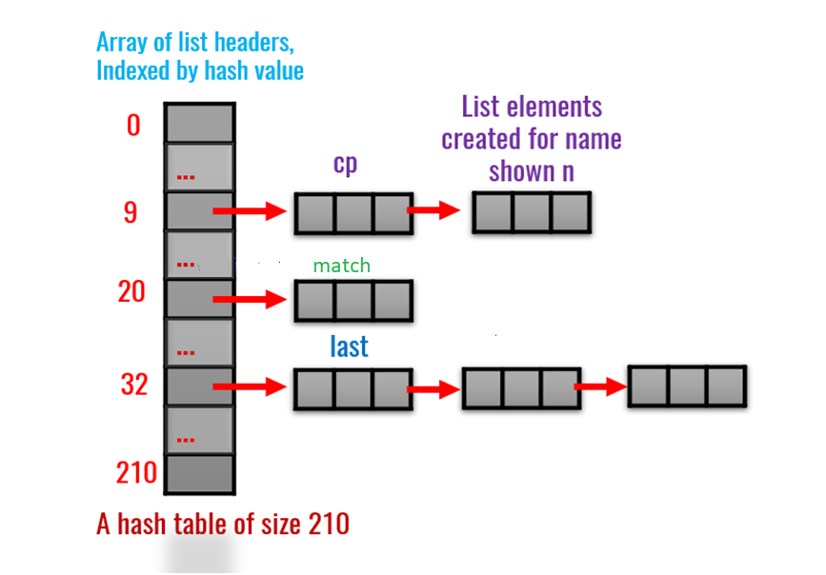

Slide 118
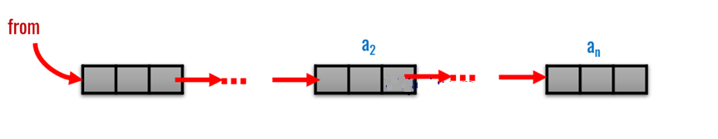
Representing Scope Information
A simple approach is to maintain a separate symbol table for each scope.
The symbol table for a procedure or scope is the compile time equivalent of an activation record.
Linked list is best to represent the Scope Information.

Slide 119
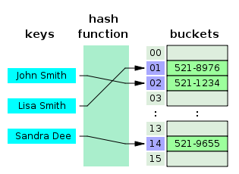
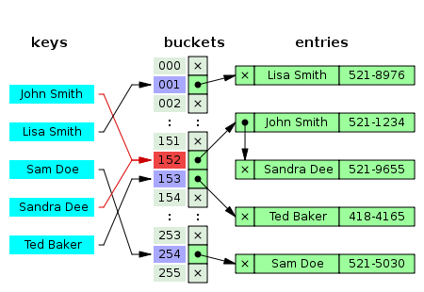
The hash function will assign each key to a unique bucket.
But most hash table designs employ an imperfect hash function, which might cause hash collisions where the hash function generates the same index for more than one key.
A small phone book as a hash table
Hash collision resolved by separate chaining.

Slide 120
Binary Search Tree
Another approach to implement symbol table is to use binary search tree i.e. add two link fields (left and right child)
All names are created as child of root node that always follow the property of binary search tree.
Insertion and lookup are O(log₂ n) on average.
Binary tree search routine
While P≠ null do /*P is initailly a pointer to the root*/
if NAME=NAME(P) then
NAME found,do required action
else if NAME < NAME(P) then
P=LEFT(P) /* visit left child*/
else P=RIGHT(P) /* visit right child*/
/*if we fall through the loop ,we have failed to find NAME */

Slide 121
Data structure for symbol table
A compiler contains two type of symbol table:
global symbol table and
scope symbol table.
Global symbol table can be accessed by all the procedures and scope symbol table.

Slide 122
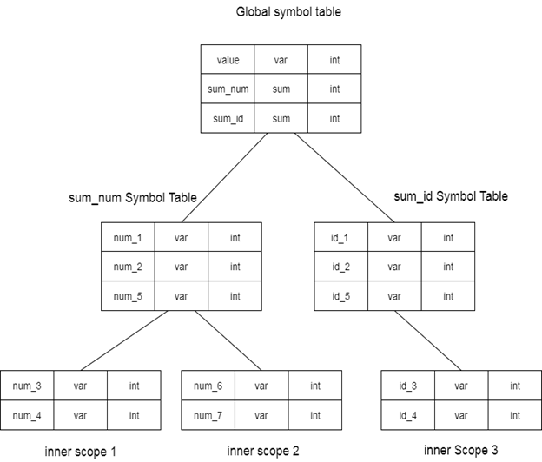
The scope of a name and symbol table is arranged in the hierarchy structure as shown below:
int value=10;
int sum_num()
{
int num_1;
int num_2;
{
int num_3; int num_4;
}
int num_5;
{
int_num 6; int_num 7;
}
}
int sum_id
{
int id_1;
int id_2;
{
int id_3; int id_4; }
int num_5; }

Slide 123
The global symbol table contains one global variable and two procedure names. The name mentioned in the sum_num table is not available for sum_id and its child tables.

Slide 124
Improvised Symbol Table Structure
Symbol table is the environment where the variables and functions/methods exist according to their scope and the most recent updated values are kept for the successful running of the code.
It helps in code functioning. It is created during compilation and maintained, used during running of the code.
Adding a utility called common file can help in conversion of one code to another code.
As common file can be explained as the file containing the common functionalities of different languages, say, every language has a print function but with different syntax; these different syntax of print are added in common file which help in the conversion.

Slide 125
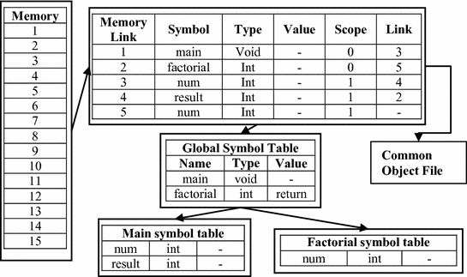
Improvised Symbol Table Structure

Slide 126
THANK YOU

